Slide 1
Chapter 2
Database Concepts

Slide 2
In this chapter, you will learn:
The difference between data and information
What a database is, about different types of databases, and why they are valuable assets for decision making
Why database design is important
How modern databases evolved from files and file systems

Slide 3
In this chapter, you will learn (continued):
About flaws in file system data management
How a database system differs from a file system, and how a DBMS functions within the database system
About data storage and retrieval strategies

Slide 4
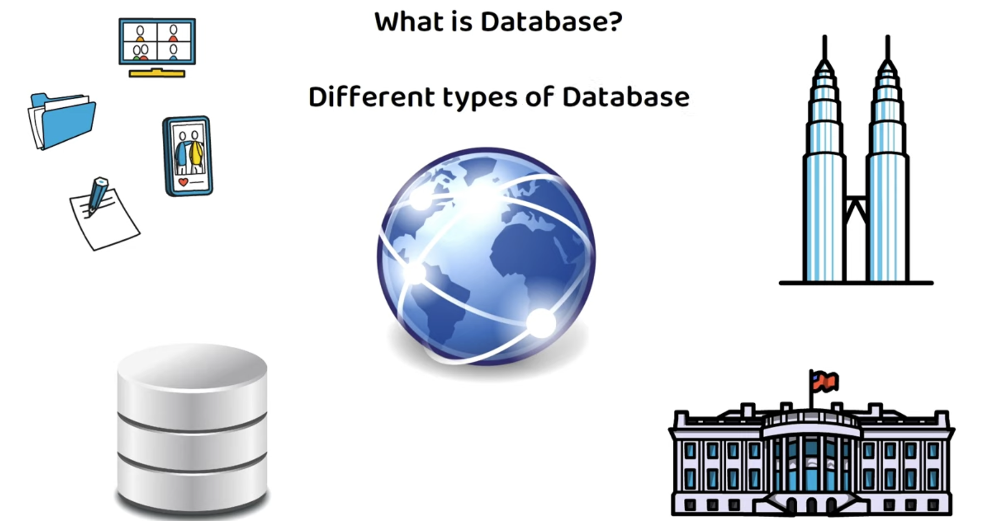

Slide 5
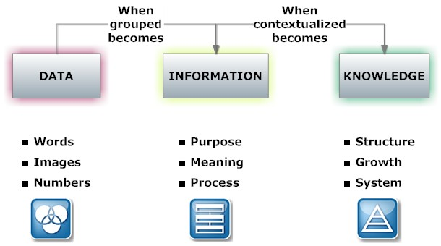
Data vs. Information
Data | Information
Raw facts Raw data - Not yet been processed to reveal the meaning Building blocks of information Data management Generation, storage, and retrieval of data | Produced by processing data Reveals the meaning of data Enables knowledge creation Should be accurate, relevant and timely to enable good decision making
Accurate, relevant, and timely information is key to good decision making
Good decision making is key to survival in global environment

Slide 6
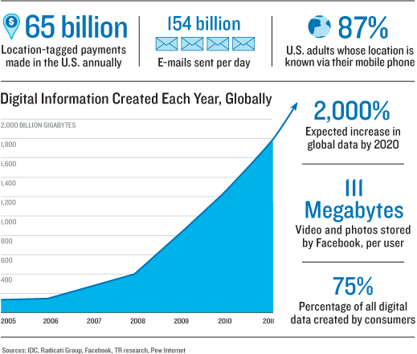
Meaningful Information - example

Slide 7
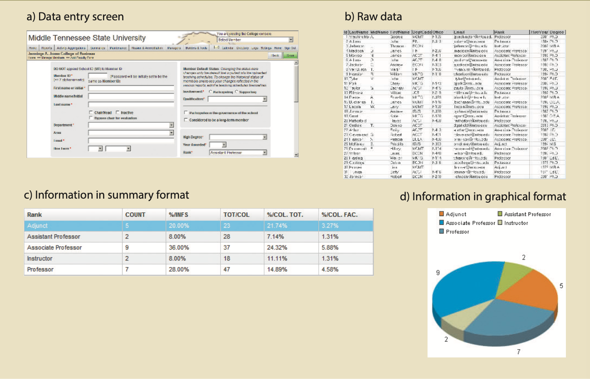
Transforming raw data into information - example
Database Systems: Design, Implementation, & Management, 12th Edition, Rob & Coronel

Slide 8
Data Management Trends
Computer File-based System
Paper File-based
Database
Data Warehouse And Data mining
Read:
http://cnx.org/content/m28156/latest/
Sighted 09/05/2014

Slide 9
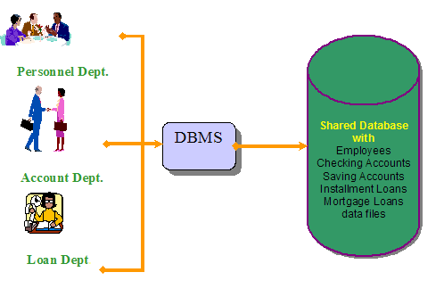
Database Approach
Database—shared, integrated computer structure that houses:
End user data: Raw facts of interest to end user
Metadata: Data about data, which end-user data are integrated and managed
Notes:
A shared, integrated computer structure that houses a collection of related data. A database contains two types of data: end-user data (raw facts) and metadata.

Slide 10
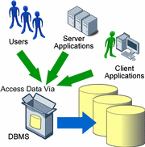
Database Approach
DBMS (database management system):
Collection of programs that manages database structure and controls access to data
Possible to share data among multiple applications or users
Makes data management more efficient and effective
Notes:
A database management system (DBMS) is a collection of programs that manages the database structure and controls access to the data stored in the database.

Slide 11
DBMS Makes Data Management More Efficient and Effective
End users have better access to more and better-managed data
Promotes integrated view of organization’s operations
Better understanding and minimize errors VS individualistic view (the story of the 4 blind man describing an elephant)
Probability of data inconsistency is greatly reduced
Possible to produce quick answers to ad hoc queries
Notes:
https://medium.com/betterism/the-blind-men-and-the-elephant-596ec8a72a7d

Slide 12
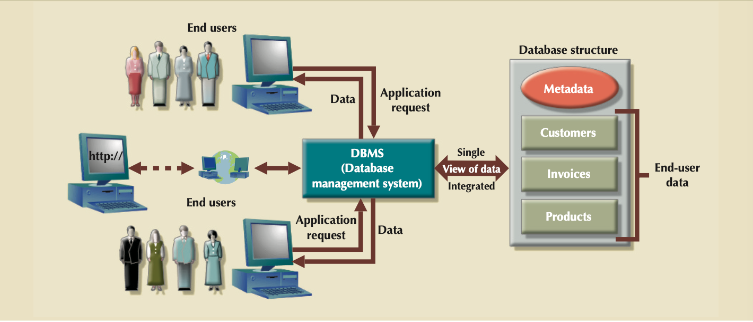
The DBMS Manages the Interaction Between the End User and the Database

Slide 13
Types of Databases
Single-user:
Supports only one user at a time
Desktop:
Single-user database running on a personal computer
Multi-user:
Supports multiple concurrent users at the same time

Slide 14
Types of Databases (continued)
Workgroup:
Multi-user database that supports a small group of users or a single department
Enterprise:
Multi-user database that supports a large group of users or an entire organization

Slide 15
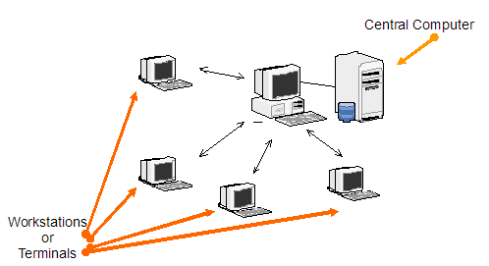
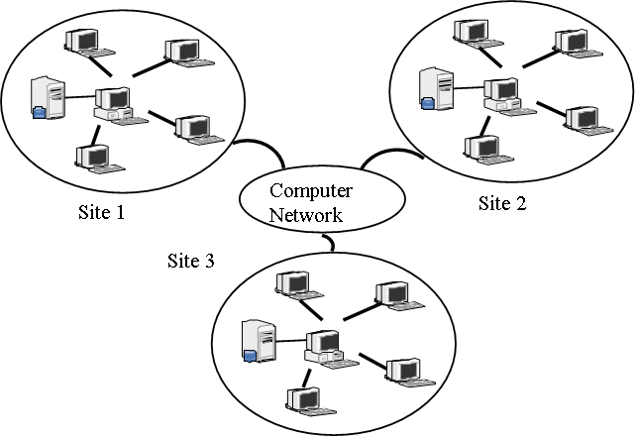
Location of Databases
Centralized:
Supports data located at a single site
Distributed:
Supports data distributed across several site

Slide 16
Uses of Databases
Transactional (or production):
Supports a company’s day-to-day operations
Data warehouse:
Stores data used to generate information required to make tactical or strategic decisions
Such decisions typically require “data massaging”
Often used to store historical data

Slide 17
Why Database Design is Important
Defines the database’s expected use
Different approach needed for different types of databases
Avoid redundant data (unnecessarily duplicated)
A poorly designed database may lead to poor decision making—and poor decision making can lead to the failure of an organization.

Slide 18
Manual File Systems
Traditionally composed of collection of file folders kept in file cabinet
Organization within folders was based on data’s expected use (ideally logically related)
System was adequate for small amounts of data with few reporting requirements
Finding and using data in growing collections of file folders became time-consuming and cumbersome

Slide 19
Conversion from Manual File System to Computer File System
Could be technically complex, requiring hiring of data processing (DP) specialists
DP specialists created file structures, wrote software, and designed application programs
Resulted in numerous “home-grown” systems being created
Initially, computer files were similar in design to manual files
Notes:
The person responsible for developing and managing a computerized file processing system.

Slide 20
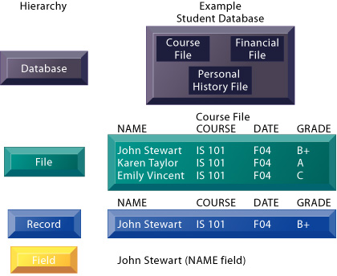
Components of a File
Notes:
https://paginas.fe.up.pt/~acbrito/laudon/ch7/chpt7-1main.htm

Slide 21
Example of Early Database Design
DP specialist wrote programs for reports:
Monthly summaries of types and amounts of insurance sold by agents
Monthly reports about which customers should be contacted for renewal
Reports that analyzed ratios of insurance types sold by agent
Customer contact letters summarizing coverage
Additional reports were written as required

Slide 22
Example of Early Database Design (continued)
Other departments requested databases be written for them
SALES database created for sales department
AGENT database created for personnel department

Slide 23
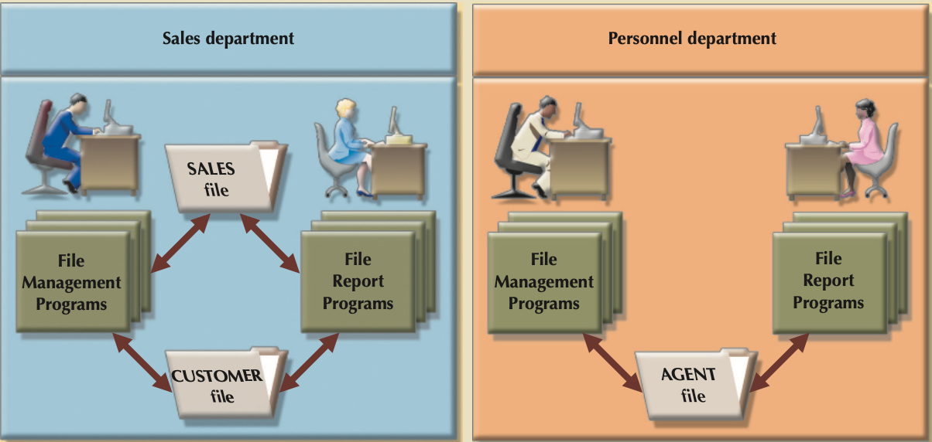
Evolution of Simple File System
As number of databases increased, small file system evolved
Each file used its own application programs
Each file was owned by individual or department who commissioned its creation

Slide 24
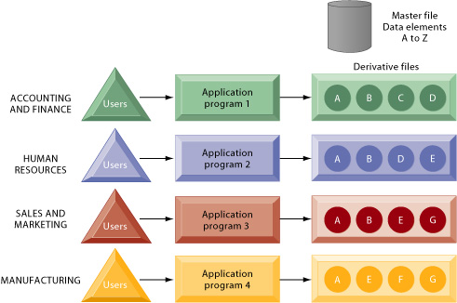
File-based System
Each of the files in the systems used its own application programs to store, retrieve and modify data
Each file was owned by the department that created it.

Slide 25
Problems with File System Data Management
Every task requires extensive programming in a third-generation language (3GL)
Programmer must specify task and how it must be done
Modern databases use fourth-generation language (4GL)
Allows user to specify what must be done without specifying how it is to be done

Slide 26
Programming in 3GL
Time-consuming, high-level activity
Programmer must be familiar with physical file structure
As system becomes complex, access paths become difficult to manage and tend to produce malfunctions
Complex coding establishes precise location of files and system components and data characteristics

Slide 27
Programming in 3GL (continued)
Ad hoc queries are impossible
Writing programs to design new reports is time consuming
As number of files increases, system administration becomes difficult
Making changes in existing file structure is difficult
File structure changes require modifications in all programs that use data in that file
Modifications are likely to produce errors, requiring additional time to “debug” the program
Security features hard to program and therefore often omitted

Slide 28
Structural and Data Dependence
Structural dependence
Access to a file depends on its own structure
Data dependence
Changes in database structure affect program’s ability to access data
Logical data format
How a human being views the data
Physical data format
How the computer “sees” the data

Slide 29
Data Redundancy
Data redundancy results in data inconsistency
Different and conflicting versions of the same data appear in different places
Errors more likely to occur when complex entries are made in several different files and recur frequently in one or more files
Data anomalies develop when required changes in redundant data are not made successfully

Slide 30
Data Anomalies
Unable to perform certain data maintenance due to errors in database design
Modification anomalies
Occur when changes must be made to existing records
Insertion anomalies
Occur when entering new records
Deletion anomalies
Occur when deleting records

Slide 31
Database vs. File System
Problems inherent in file systems make using a database system desirable
File system
Many separate and unrelated files
Database
Logically related data stored in a single logical data repository

Slide 32
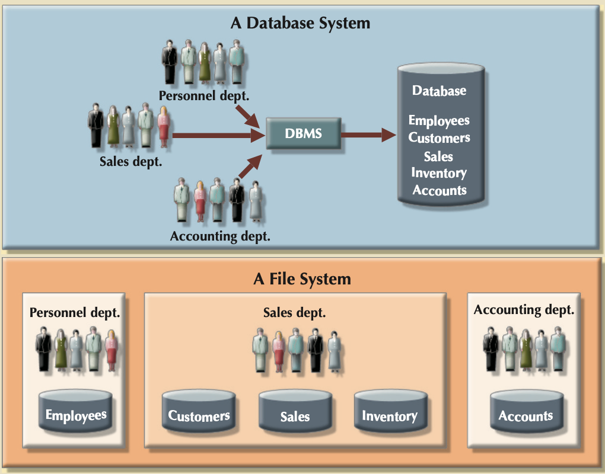
Contrasting Database and File Systems

Slide 33
The Database System Environment
Database system is composed of 5 main parts:
Hardware
Software
Operating system software
DBMS software
Application programs and utility software
People
Procedures
Data

Slide 34
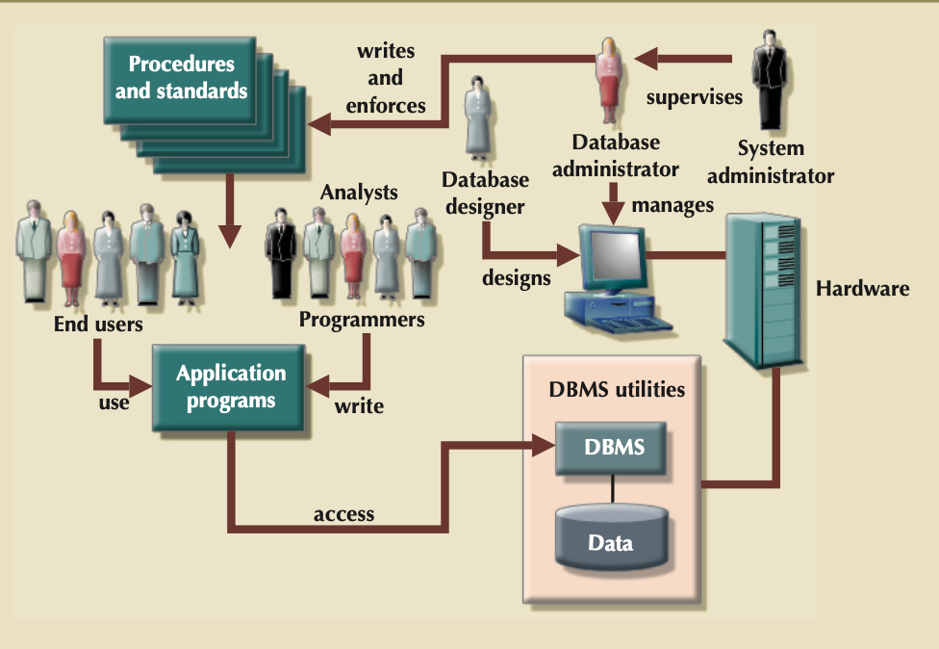
The Database System Environment (continued)

Slide 35
DBMS Functions
Performs functions that guarantee integrity and consistency of data
Data dictionary management
defines data elements and their relationships
Data storage management
stores data and related data entry forms, report definitions, etc.
Data transformation and presentation
translates logical requests into commands to physically locate and retrieve the requested data

Slide 36
DBMS Functions (continued)
Security management
enforces user security and data privacy within database
Multi-user access control
creates structures that allow multiple users to access the data
Backup and recovery management
provides backup and data recovery procedures

Slide 37
DBMS Functions (continued)
Data integrity management
promotes and enforces integrity rules to eliminate data integrity problems
Database access languages and application programming interfaces
provides data access through a query language
Database communication interfaces
allows database to accept end-user requests within a computer network environment

Slide 38
Summary
Information is derived from data, which is stored in a database
To implement and manage a database, use a DBMS
Database design defines its structure
Good design is important

Slide 39
Summary (continued)
Databases were preceded by file systems
Because file systems lack a DBMS, file management becomes difficult as a file system grows
DBMS were developed to address file systems’ inherent weaknesses

Slide 40
Physical data storage concepts
Homework – Reading Assignment
What are the media and devices?
How does it actually work?
What are the most common operations on files?
Typical files storage methods and its uses
How to make access to data faster?
How to make storage of data more permanent?
Indexing files to facilitate faster records access
Reference: Fundamentals of Database Systems, 6th Ed, Elmasri, Navathe - chapters 17,18

Slide 41
Physical data storage concepts
Disk Storage Devices
Files of Records
Operations on Files
Unordered Files
Ordered Files
Hashed Files
Dynamic and Extendible Hashing Techniques
RAID Technology
Indexed File
Reference: Fundamentals of Database Systems, 6th Ed, Elmasri, Navathe - chapters 17,18

Slide 42
Operation on Files
Typical file operations include:
OPEN: Readies the file for access, and associates a pointer that will refer to a current file record at each point in time.
FIND: Searches for the first file record that satisfies a certain condition, and makes it the current file record.
FINDNEXT: Searches for the next file record (from the current record) that satisfies a certain condition, and makes it the current file record.
READ: Reads the current file record into a program variable.
INSERT: Inserts a new record into the file & makes it the current file record.
DELETE: Removes the current file record from the file, usually by marking the record to indicate that it is no longer valid.
MODIFY: Changes the values of some fields of the current file record.
CLOSE: Terminates access to the file.
REORGANIZE: Reorganizes the file records.
For example, the records marked deleted are physically removed from the file or a new organization of the file records is created.
READ_ORDERED: Read the file blocks in order of a specific field of the file.

